Slide 1
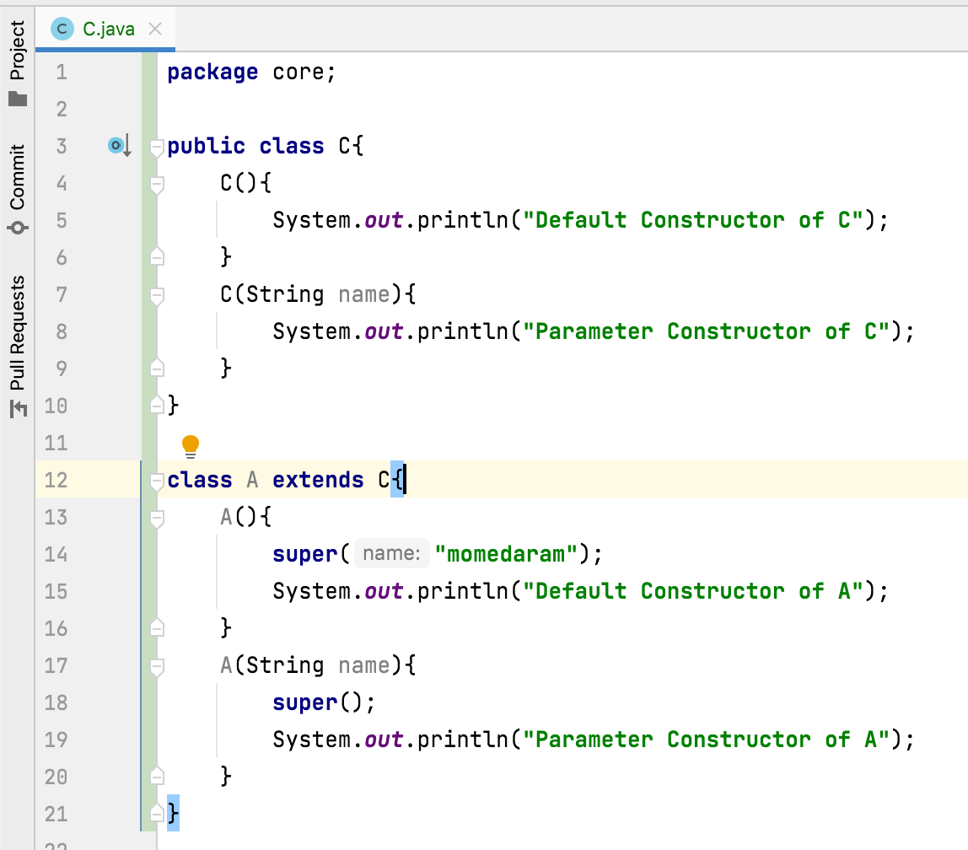
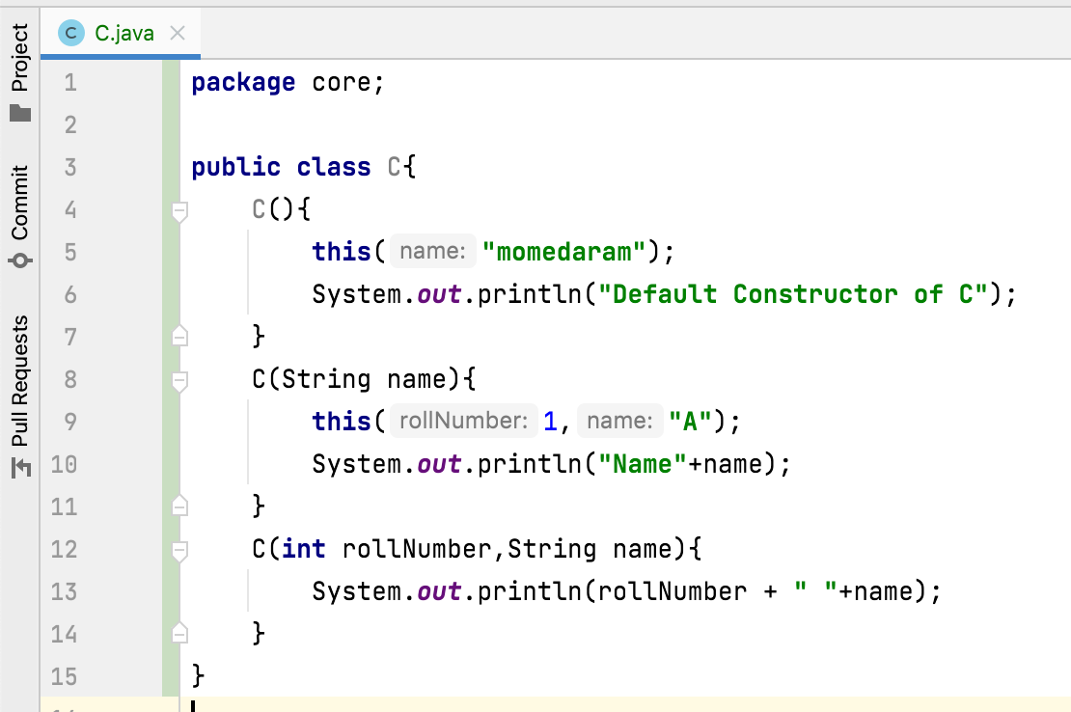
What is the difference between super() and this()?
super() : Is used to call super class constructor.
this() : Is used to call same (current ) class constructor.

